Slide 1

Sales Predictions for Food and Items
By: Alicia Lizarraga
March 2022

Slide 2
Business Problem
The goal of this prediction is to help the retailer understand the properties of products and outlets that play crucial roles in increasing sales for future prospects

Slide 3
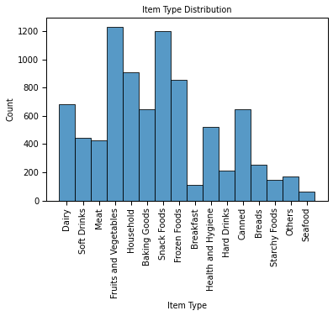
Is the Item Type relevant to Outlet Sales?
Fruits and Vegetables are very high on the scale
Snack Foods are very high as well
Certain food items do outweigh other group categories

Slide 4
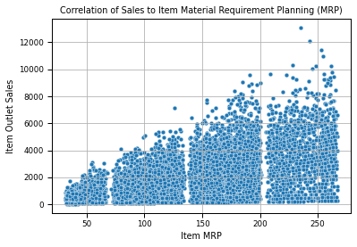
Is MRP relevant to Outlet Sales?
As MRP increases the sales increase
The plot has a cluster around certain ranges

Slide 5
Trend & Insights
Item Type
MRP
Column “Fruits and Vegetables” and “Snack Foods” were the highest in sales around the 1200 mark
Consumer audience infers that they tend to eat more healthier
MRP increasing with more production and sales

Slide 6
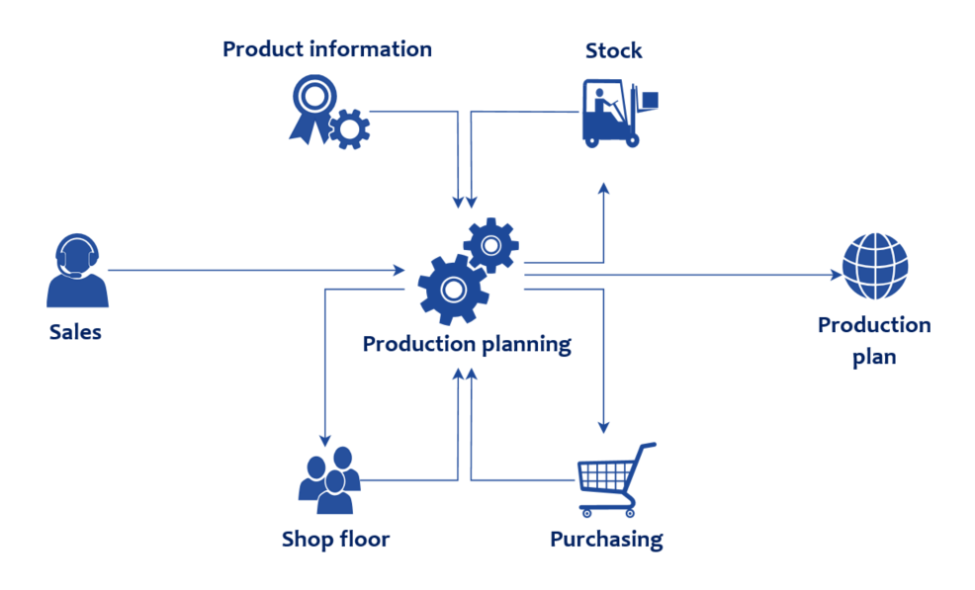
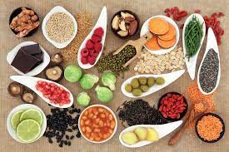
Recommendations for Stakeholders
In conclusion, it would be best for retailers and stakeholders to output a higher/ refined MRP to increase sales
As well focus on more healthier food choices as fruits and veggies and snacks, since the audience is trying to be healthier

Slide 7
Thank you!

